Slide 1

Lesson 5.2 Cloning sprites
Microsoft Philanthropies TEALS Program
Introduction to Computer Science

Slide 2
Cloning sprites
After this lesson, you will be able to...
Demonstrate the difference between sprite and global variables.
Explain how cloning and prototyping simplify working with numerous similar sprites in the same program.
Create prototype sprites and clones of the prototype sprite.
Explain the difference between a "master" sprite and a "clone" sprite.

Slide 3
Today’s plan
Do now
Introductory discussion
Lab Activity
Debrief
Notes:
Duration Description
5 minutes | Do Now
15 minutes | Introductory discussion
30 minutes | Lab: Lots of Balls
15 minutes | Debrief and wrap-up

Slide 4

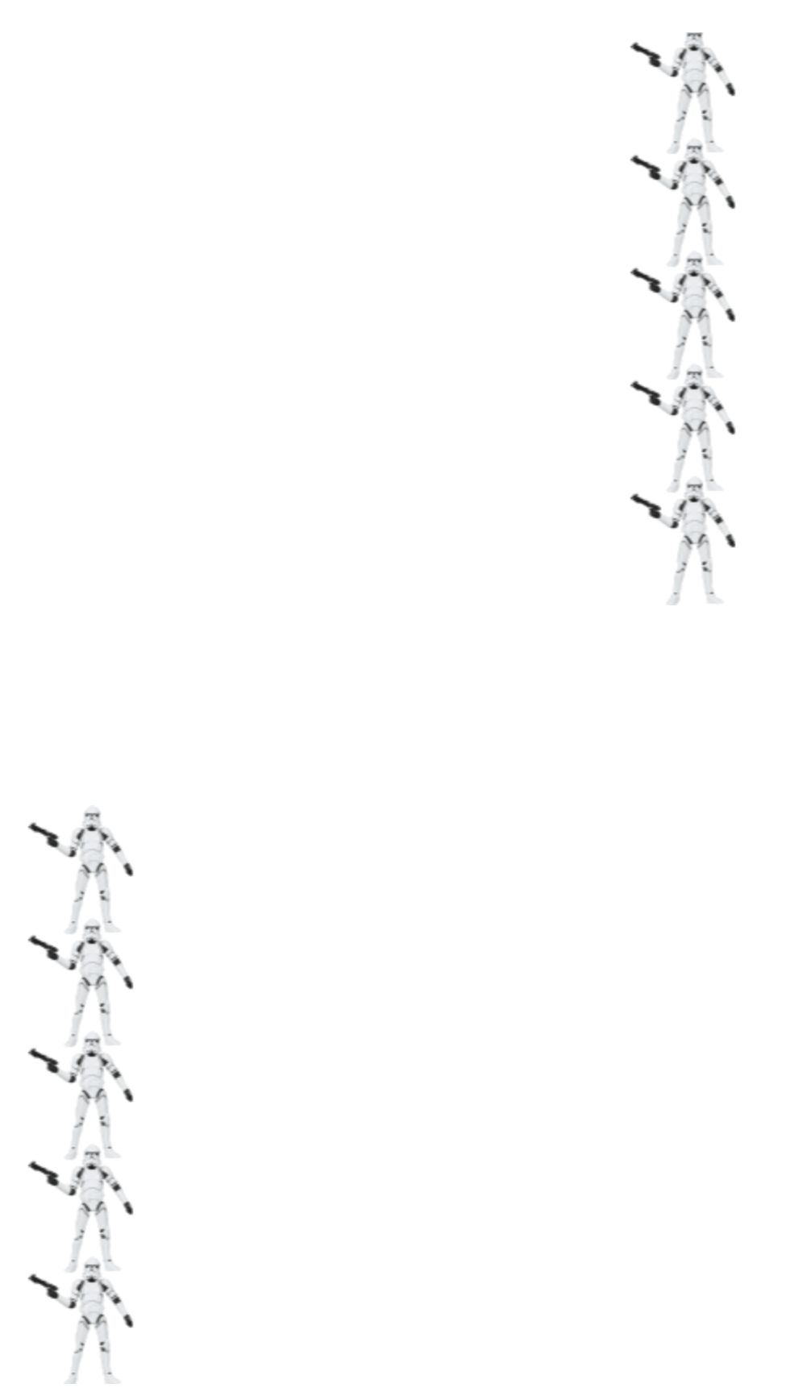
Do Now 5.2: Star war troopers
Start:
In Star Wars, what are "clone troopers"? Do an internet search to find out and write a sentence to answer the question.
Open this starter project. Duplicate the sprite (and scripts) so that there are 5 clone troopers that move from the right side of the screen to the left side in a straight line when green flag is clicked.
Save your projects as DoNow5.2
End:
Notes:
http://snap.berkeley.edu/snapsource/snap.html#present:Username=whuangpha&ProjectName=160425%20Do%20Now%20cloning

Slide 5

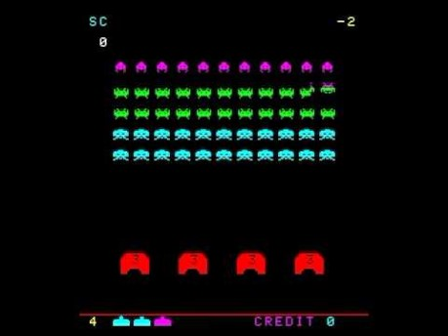
Example Game: Space Invaders
Notes:
Show students a brief video demonstrating space invaders: https://www.youtube.com/watch?v=kR2fjwr-TzA

Slide 6
Discussion
Think-Pair-Share
How can we create all the “invaders”?
What might go wrong with this approach?
Notes:
Ask students to think about how we create all the “invaders”?
Answer with current knowledge: make one invader sprite, and copy it many times while adjusting the copies as necessary
Ask what might go wrong or be bad about this approach
If anything in an invader changes, it will need to be changed many times
Lots of sprites clogging up the program that are all basically doing the same thing

Slide 7

Demonstration
Demonstrate how to create a clone using create a clone of block.
Demonstrate how to use when I start as a clone block.
Notes:
Introduce cloning as the automated way of doing the manual copying
Demonstrate the how to create a clone using the “create a clone of ____” block
Point out that clones inherit all aspects of the "master" or "prototype" sprite, including scripts
Emphasize the importance of using “when I start as a clone” block to ensure clones don't duplicate out of control

Slide 8

Lab activity 5.2: Lots of balls
In this lab, you will use cloning to create many identical sprites without having to reprogram each one individually.
Lab components:
One bouncing sprite
Sprite controlled by stage
Clones created by stage
Hide master sprite
Bonus: Sprites have different properties
Notes:
Students should complete the Lots of Balls lab
This lab will largely duplicate the code shown in the lecture part of the lesson.
Students should focus on ensuring they are differentiating between "master" sprites and "clone" sprites, and that the stage is serving as the main "driver" for the program

Slide 9

Debrief
Share one challenge you encountered during this lab and what strategies you used to solve the problem.

Slide 10

Exit ticket
In your notebook, answer the following questions:
What is the difference between a "master" sprite and a "clone" sprite?
How can cloning and prototyping simplify working with numerous similar sprites in the same program?

